Slide 1
Predicting Mars?
STAT 442: Data Mining
Jerry He

Slide 2
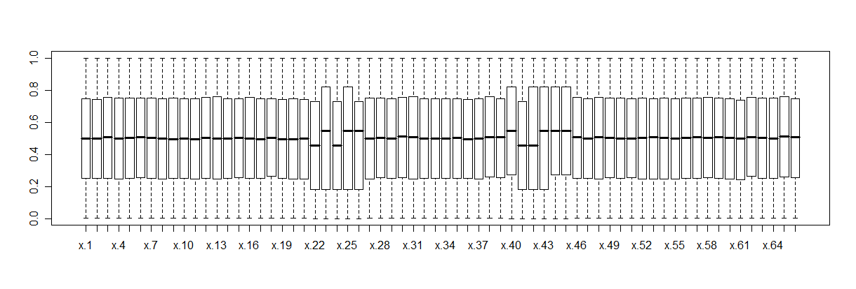
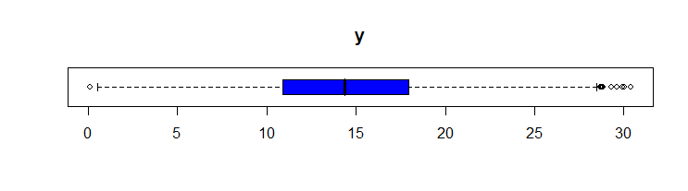
Introduction
66 input variables, one response variable

Slide 3
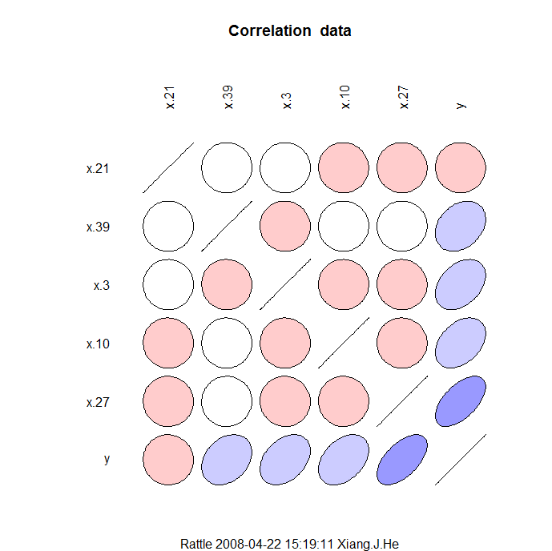
Correlation Ellipse

Slide 4
Methods
Trees, Neural Network, Random Forest, LM.
Goodness of fit criteria
  Least squares residual
  lsr <- function(x, actual) { sqrt(sum((x-actual)^2)) }
  Absolute residual
  abr <- function(x, actual) { sum(abs((x-actual))) }

Slide 5
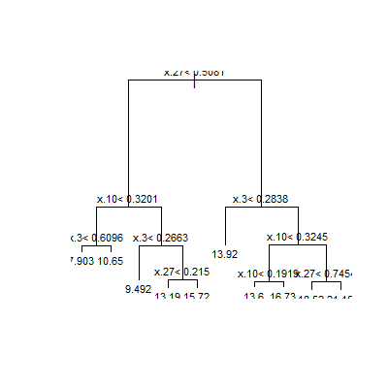
Tree

Slide 6
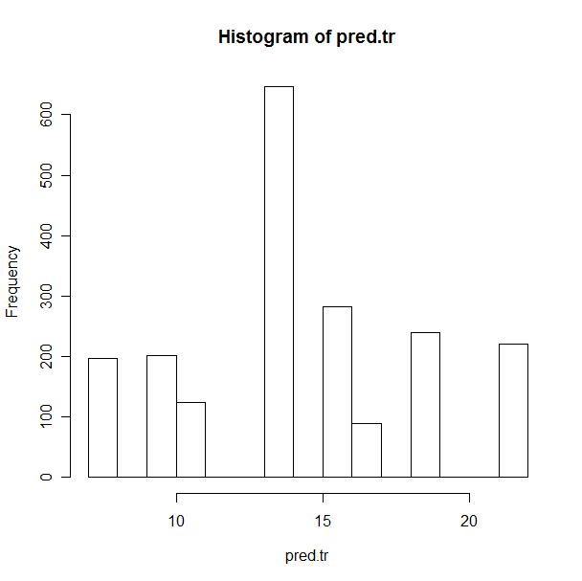
Bad output distribution
LSR | 141
ABR | 5019

Slide 7
Neural net
First Impressions
  When size=4: lsr = 185/176, abr=6649/6308
  When size=3: lsr = 189, abr=6789

Slide 8
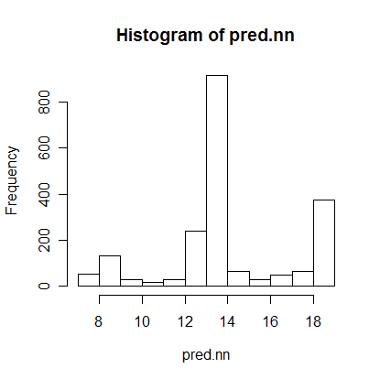
Neural net run with size=3

Slide 9
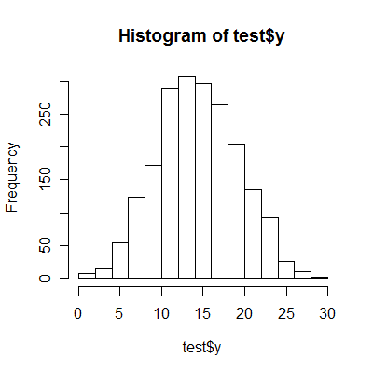
Actual distribution of test$y

Slide 10
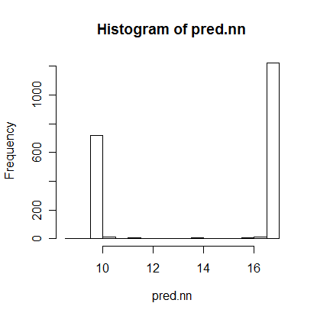
Neural net run with size=4

Slide 11
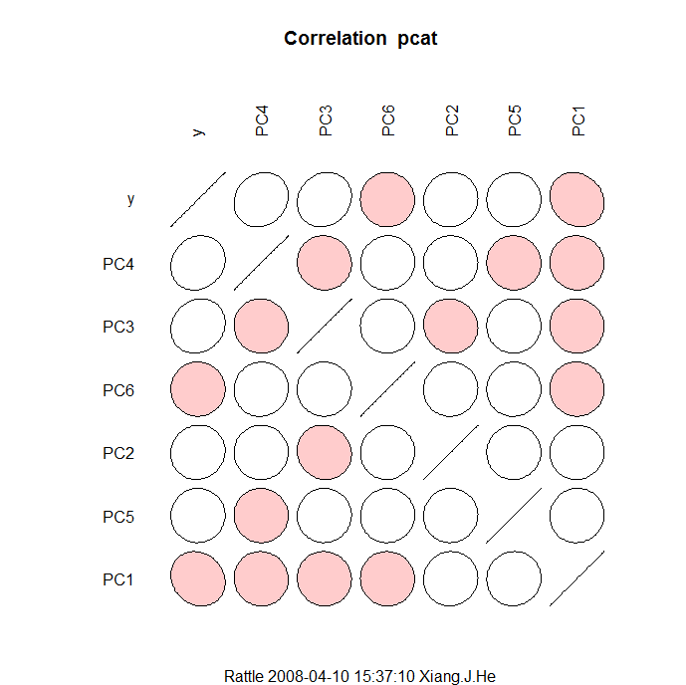
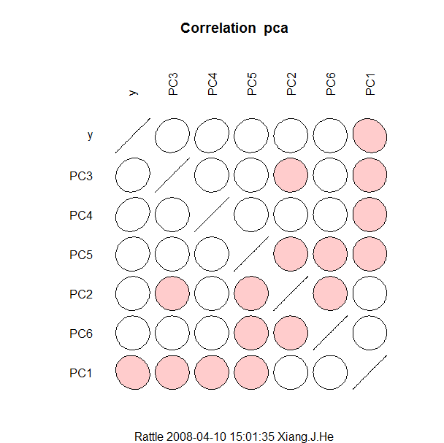
Principle Component Analysis

Slide 12
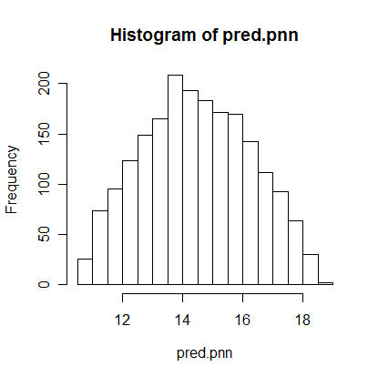
Neural net run with size=2
Principle Component Analysis
LSR | 204
ABR | 7430

Slide 13
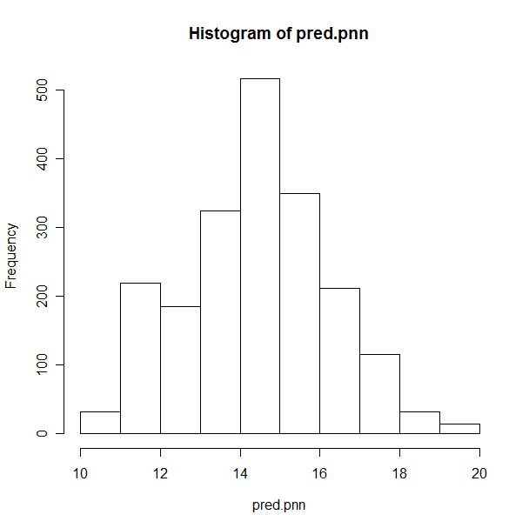
Neural net run with PCA
LSR | 204
ABR | 7437

Slide 14
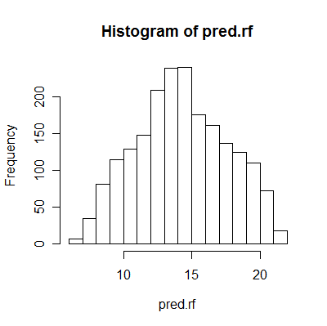
Trees
LSR | 141
ABR | 5019

Slide 15
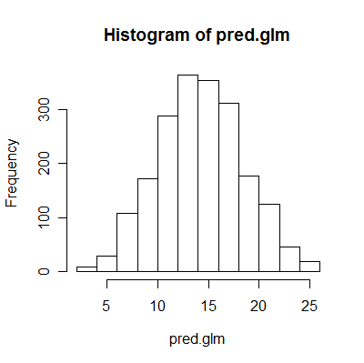
Linear Model
LSR | 116
ABR | 4085

Slide 16
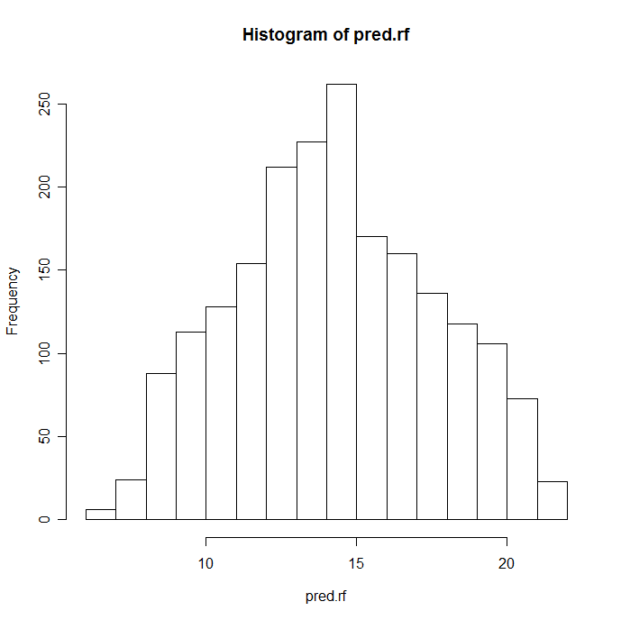
Random Forest
LSR | 102
ABR | 3649

Slide 17
K-means clustering
Unsupervised
Choose k = number of clusters
Choose k random centers
Assign points to the nearest center
Compute mean coordinates of all points in each cluster
Done when points don’t switch clusters anymore.

Slide 18
Clustering vs. no clustering
 | LM | Trees | RF | Neural Net
LSR | 116 | 141 | 102 | 217
C. LSR | 29 | 24 | 23 | 28.2
ABR | 4085 | 5019 | 3643 | 7912
C. ABR | 6279 | 3915 | 3645 | 5148

Slide 19
Clustering vs. no Clustering
 | GLM | Trees | RF | Neural Net
LSR | 116 | 141 | 102
C. LSR | 16.11 | 16.26 | 16.06 | 26
ABR | 4085 | 5019 | 3649
C. ABR | 1789 | 1807 | 1801 | 4610

Slide 20
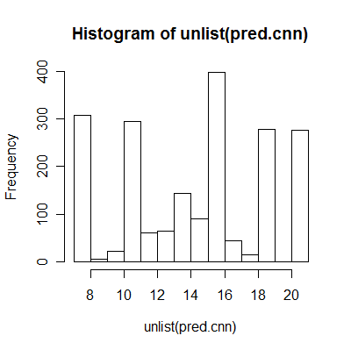
Neural net with clustering
LSR | 27
ABR | 4837

Slide 21
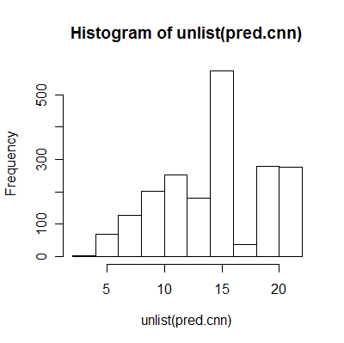
Neural Net with clustering
LSR | 26
ABR | 4610

Slide 22
Advanced Clustering
How many clusters to choose?

Slide 23
Future explorations
More clusters ➔ more Gaussian shape?
Clustering -> Principle Component Analysis -> neural net?
Clustering, but for each cluster, choose from GLM or Random Forest.
Neural net is not a contender with GLM or Random Forest

Slide 24
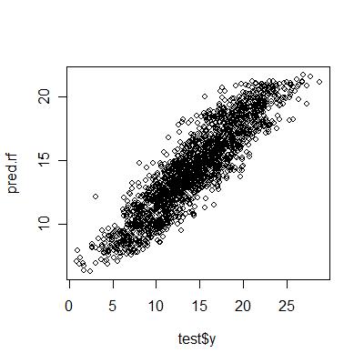
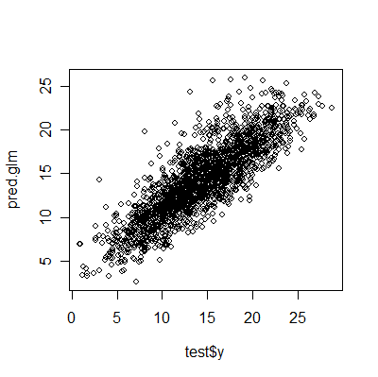
Comparing GLM to Random Forest

Slide 25
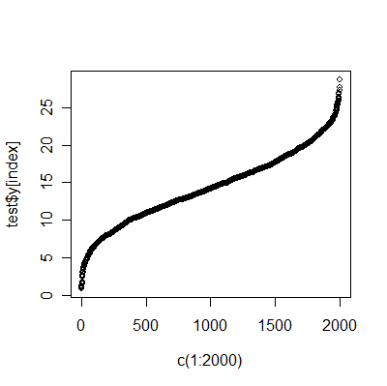
Inverse Cumulative Plot

Slide 26
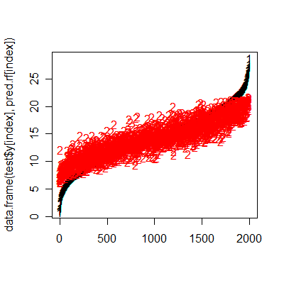
Random Forest

Slide 27
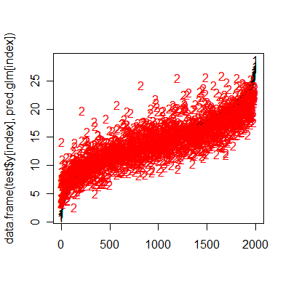
GLM

Slide 28
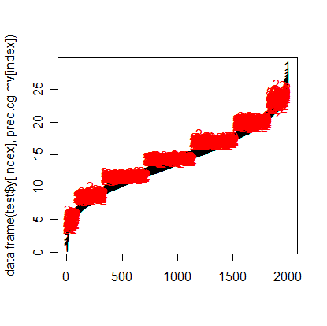
2nd Clustered LM

Slide 29
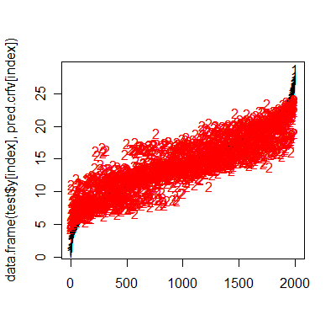
Clustered Random Forest

Slide 30
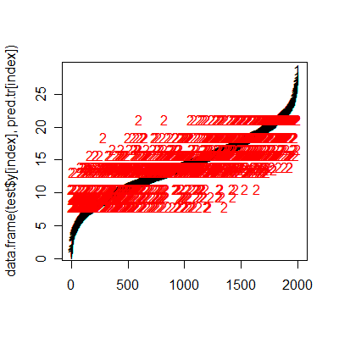
Trees

Slide 31
Further Exploration
Convert all categorical variables into 0-1 dummies
Explore the optimal # of clustering through bootstrapping
Other tree and neural net implementations
  tree
  AMORE

Slide 32
Conclusion
Data set predictors are mostly noise
Random Forest is expected to outperform all other methods for this type of dataset
Clustering can sometimes dramatically improve accuracy

